Slide 1
第七讲 类和继承

Slide 2
内容
Accessing the Inherited Members
Hiding Members of a Base Class
Base Access
Using References to a Base Class
Constructor Execution
Assemblies and Namespaces
Inheritance Between Assemblies
Member Access Modifiers
Abstract Members
Abstract Classes
Sealed Classes
Extension Methods
External Methods

Slide 3
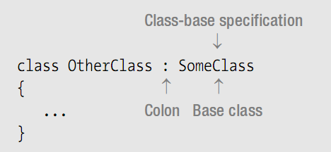
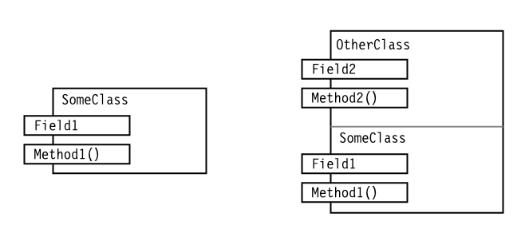
Class Inheritance
类继承
a derived class cannot delete any of the members

Slide 4
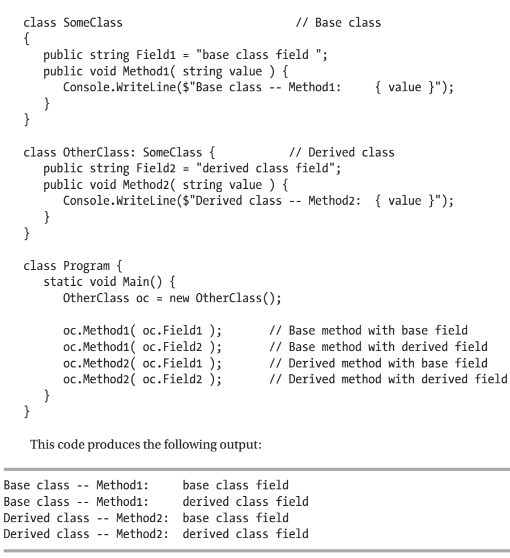
Accessing the Inherited Members
访问继承的成员
Demo

Slide 5
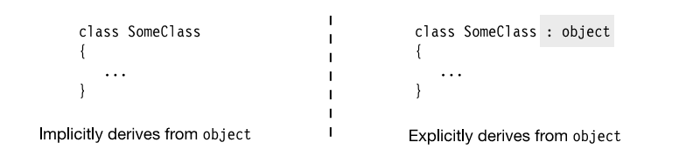
All Classes Are Derived from Class object
所有类都派生自object类

Slide 6
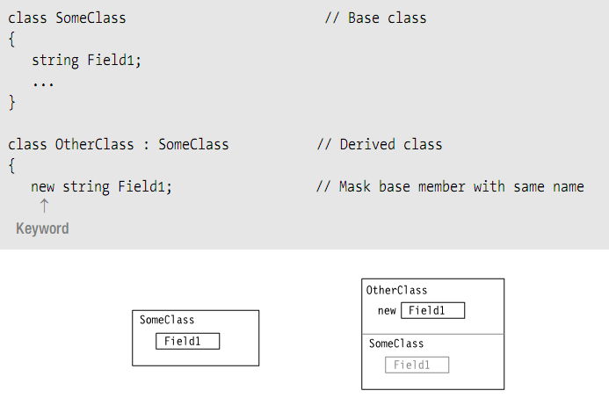
Hiding Members of a Base Class
屏蔽基类的成员

Slide 7
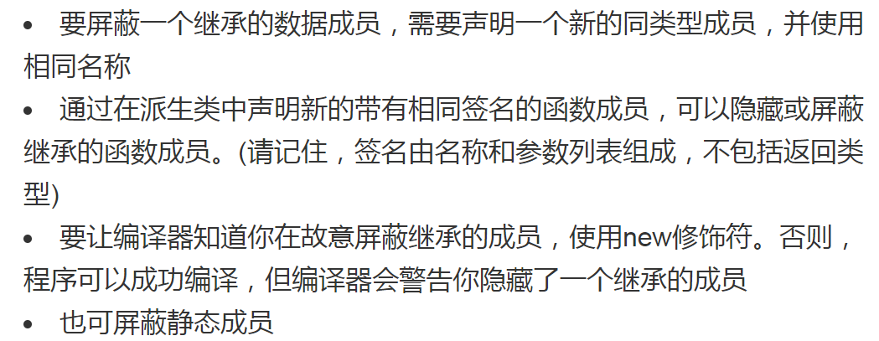
Hiding Members of a Base Class
Demo

Slide 8
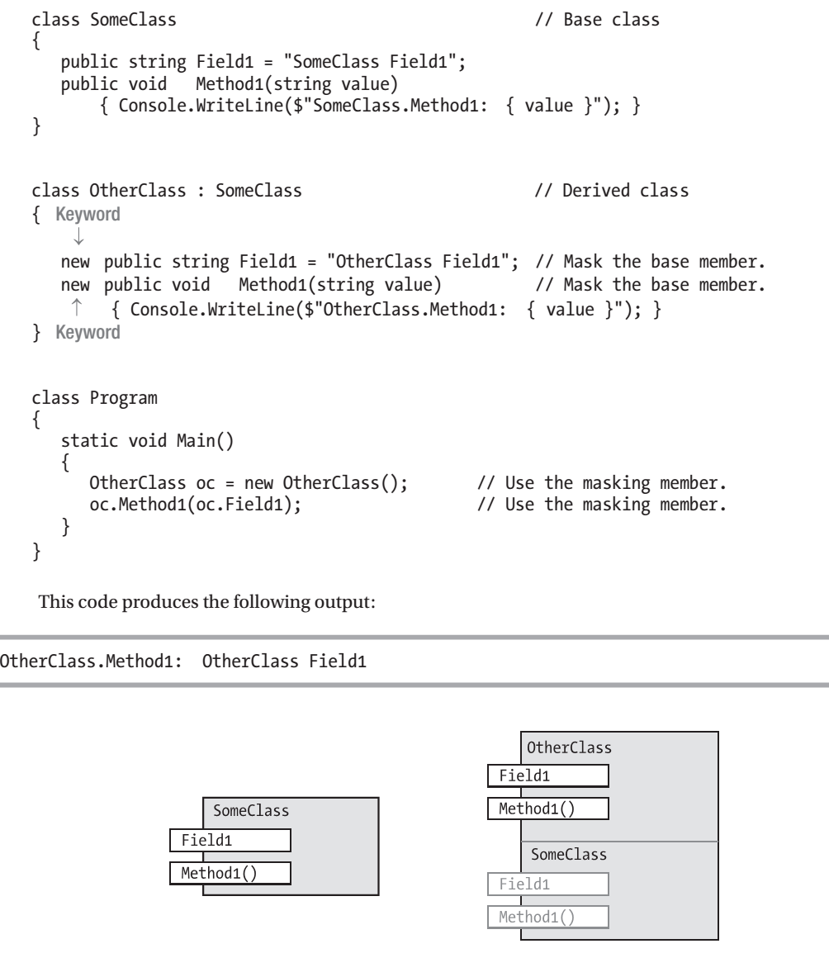

Slide 9
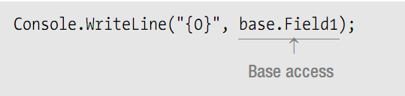
Base Access
基类访问
Sometimes, your derived class might need to access a hidden inherited member.

Slide 10
Using References to a Base Class
使用基类的引用
An instance of a derived class consists of an instance of the base class, plus the additional members of the derived class.
Demo

Slide 11
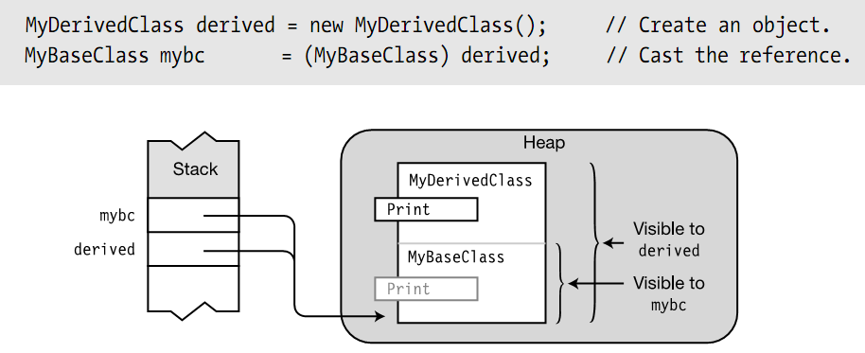

Slide 12
Virtual and Override Methods
虚方法和覆写方法
Demo

Slide 13
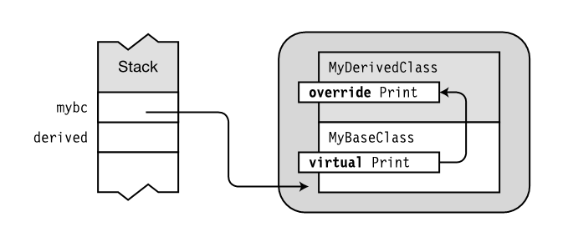

Slide 14
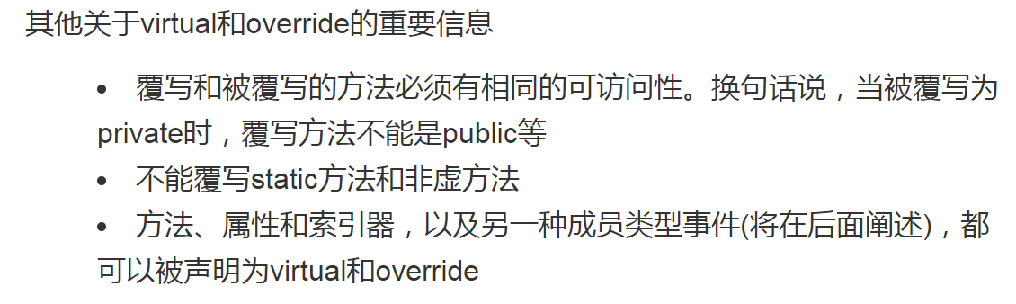

Slide 15

Overriding a Method Marked override
覆写标记为override的方法
Case 1: Declaring Print with override
Demo

Slide 16
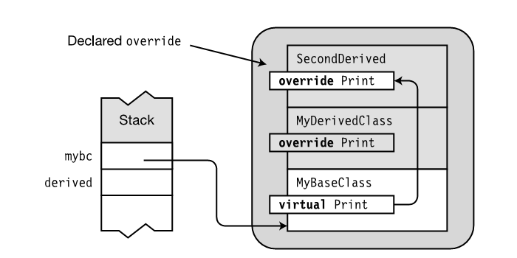

Slide 17

Case 2: Declaring Print with new
Demo

Slide 18
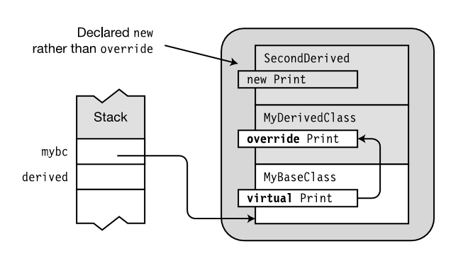

Slide 19
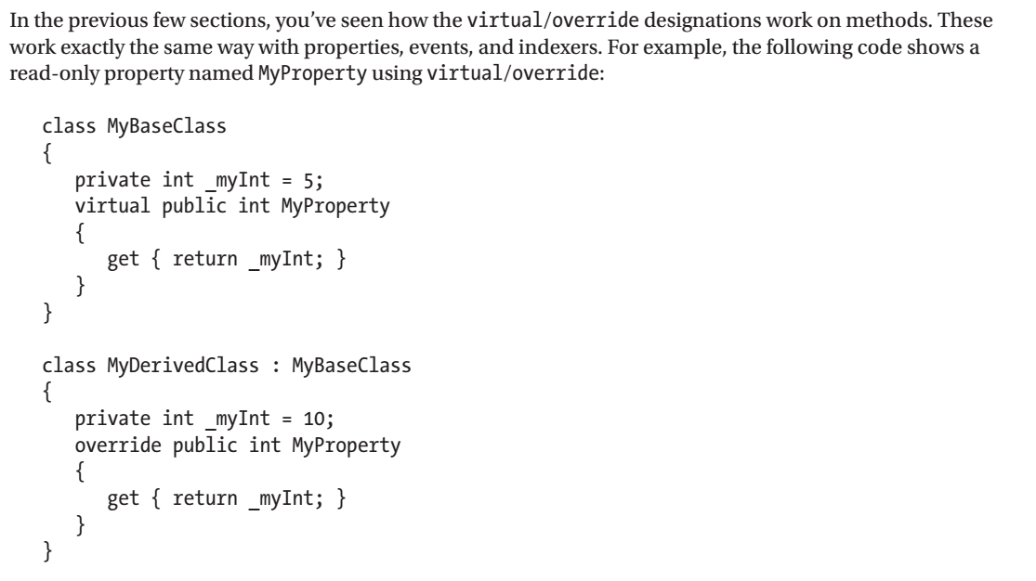
Overriding Other Member Types

Slide 20
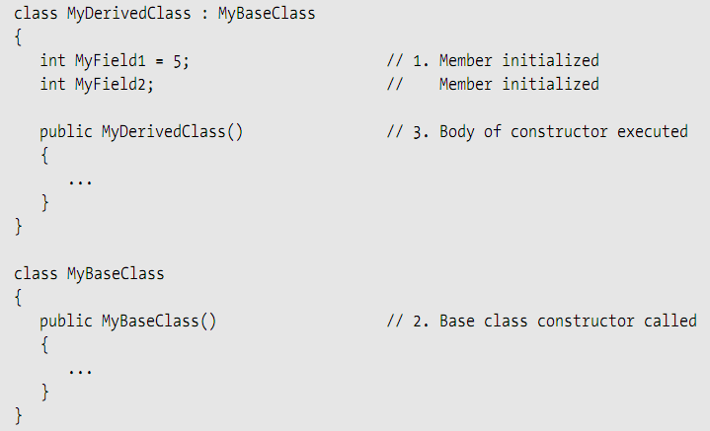
Constructor Execution
构造函数的执行

Slide 21
Constructor Initializers
By default, the parameterless constructor of the base class is called when an object is being constructed.
If you want your derived class to use a specific base class constructor other than the parameterless constructor, you must specify it in a constructor initializer.

Slide 22
Constructor Initializers
The first form uses the keyword base and specifies which base class constructor to use.

Slide 23
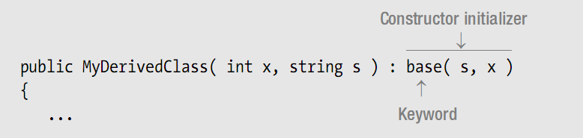
The parameters in the base parameter list must match the intended base constructor’s parameter list, in type and order.

Slide 24
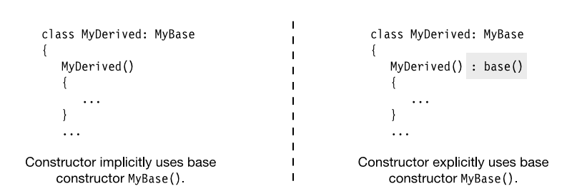
Equivalent forms of a constructor

Slide 25
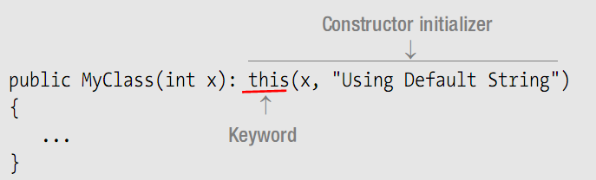
Constructor Initializers
构造函数初始化语句
The second form uses the keyword this and specifies which other constructor from this class should be used.

Slide 26
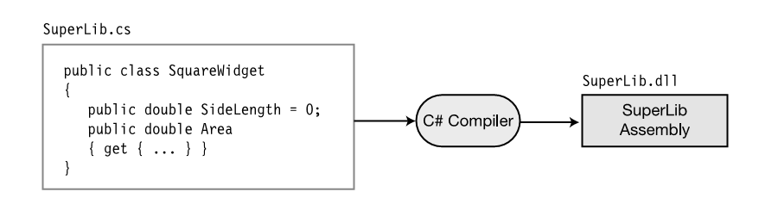
Assemblies and Namespaces
the compiler takes the source code file and produces an output file called an assembly.

Slide 27
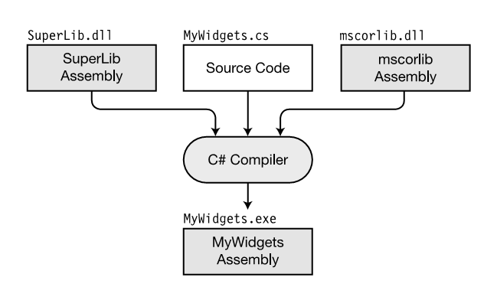
Referencing class libraries

Slide 28
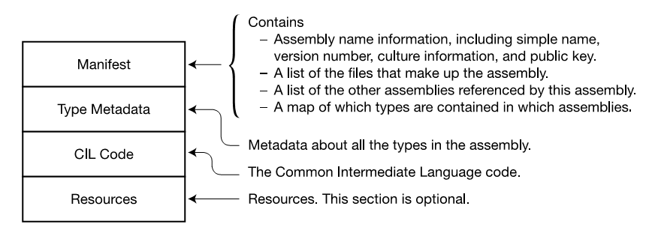
The structure of a single-file assembly

Slide 29
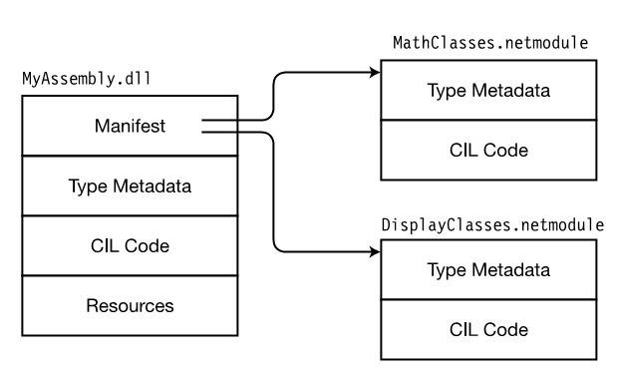
A multi-file assembly

Slide 30
Shared Assemblies and the GAC
the global assembly cache (GAC): can be shared by other assemblies on the system.
C:\WINDOWS\assembly
An assembly placed into the GAC is called a shared assembly.

Slide 31
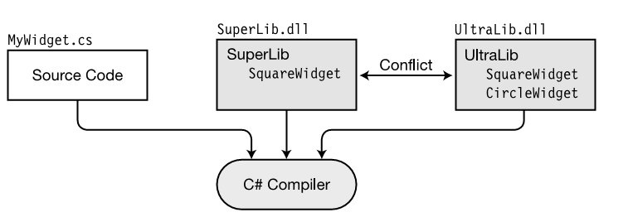
Namespaces

Slide 32
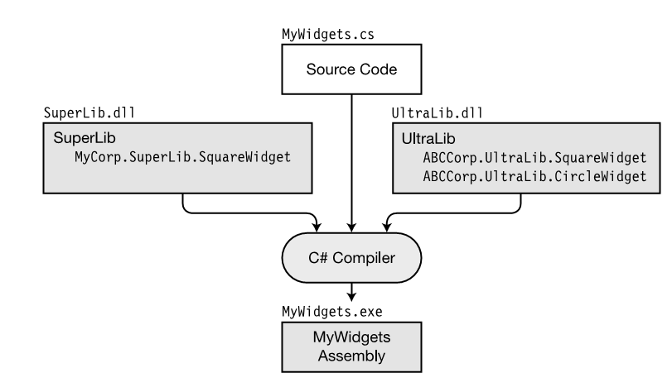
Class libraries with namespaces

Slide 33
More About Namespaces
Every type name in a namespace must be different from all the others.
The types in a namespace are called members of the namespace.
A source file can contain any number of namespace declarations, either sequentially or nested.

Slide 34
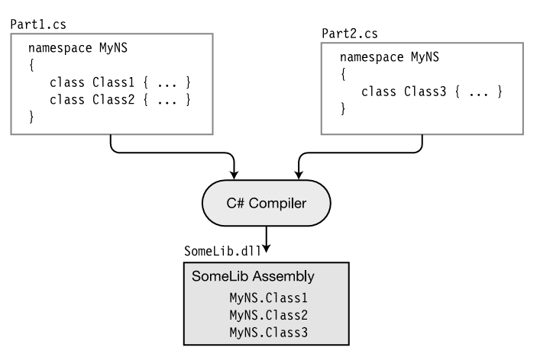
A namespace can be spread across source files and compiled to a single assembly

Slide 35
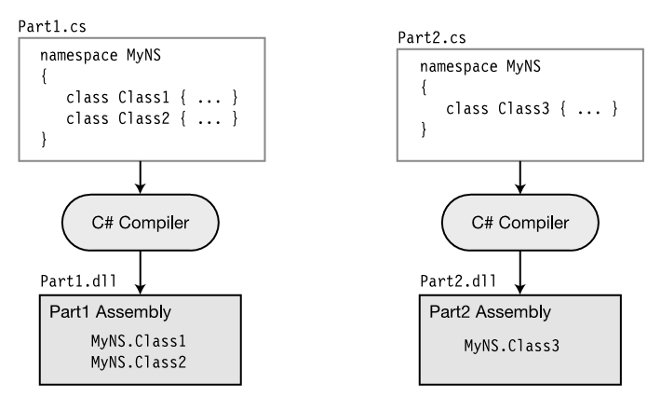
A namespace can be spread across source files and compiled to separate assemblies.

Slide 36
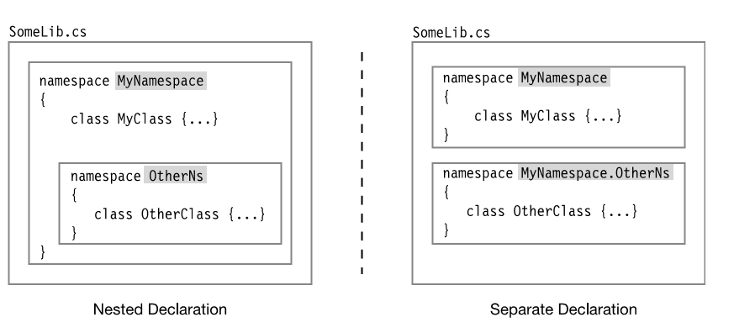
Nesting Namespaces

Slide 37
Class Access Modifiers
here are two levels of class accessibility: public and internal.
A class marked public can be accessed by code from any assembly in the system.
A class marked internal can only be seen by classes within its own assembly.
internal is the default accessibility level

Slide 38
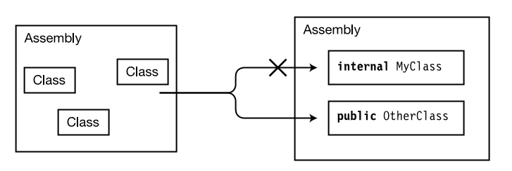
the accessibility of internal and public classes

Slide 39
Inheritance Between Assemblies
The base class must be declared public, so that it can be accessed from outside its assembly.
You must include a reference in your Visual Studio project to the assembly containing the base class.

Slide 40
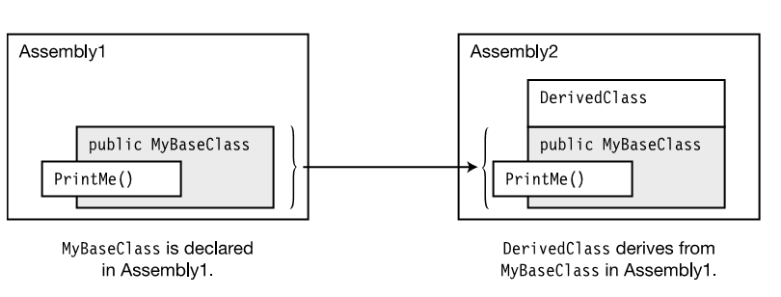

Slide 41
Member Access Modifiers
There are five member access levels:
  – public
  – private
  – protected
  – internal
  – protected internal
  - private protected（C#7.2）

Slide 42
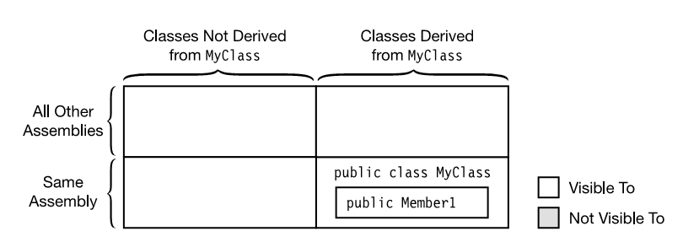
public

Slide 43
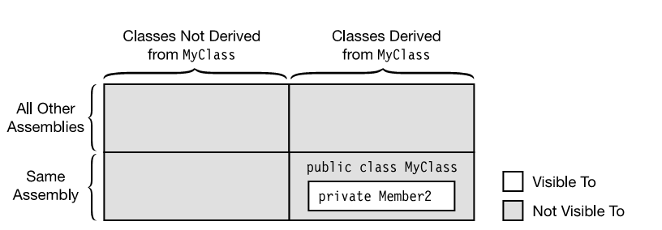
private

Slide 44
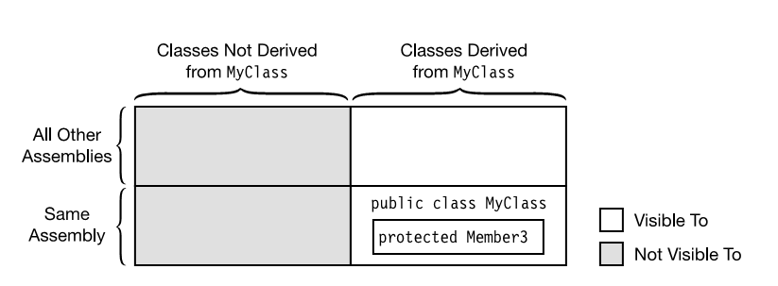
protected

Slide 45
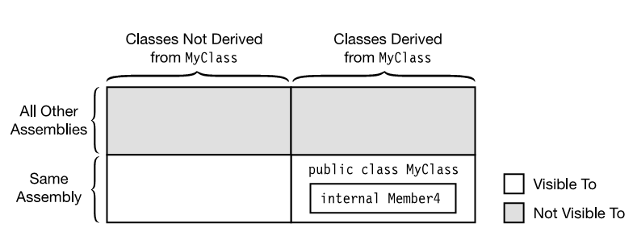
internal

Slide 46
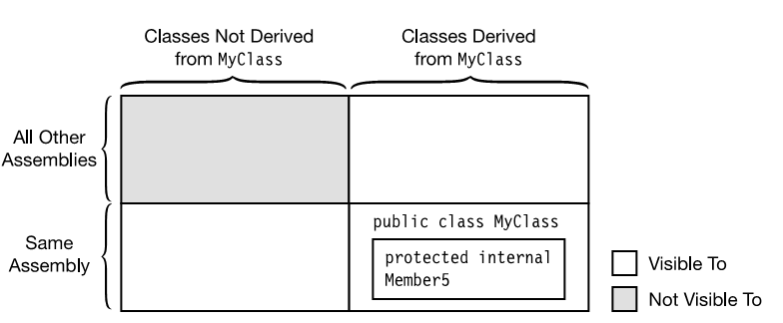
protected internal

Slide 47
private protected
// Assembly1.cs
// Compile with: /target:library
public class BaseClass
{
private protected int myValue = 0;
}
public class DerivedClass1 : BaseClass
{
void Access()
{
var baseObject = new BaseClass();
// Error CS1540, because myValue can only be accessed by
// classes derived from BaseClass.
// baseObject.myValue = 5;
// OK, accessed through the current derived class instance
myValue = 5;
}
}

Slide 48
private protected
// Assembly2.cs
// Compile with: /reference:Assembly1.dll
class DerivedClass2 : BaseClass
{
void Access()
{
// Error CS0122, because myValue can only be
// accessed by types in Assembly1
// myValue = 10;
}
}

Slide 49
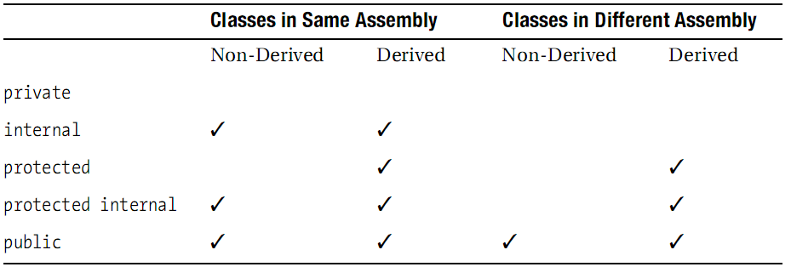
Summary of Member Accessibility
private protected √

Slide 50
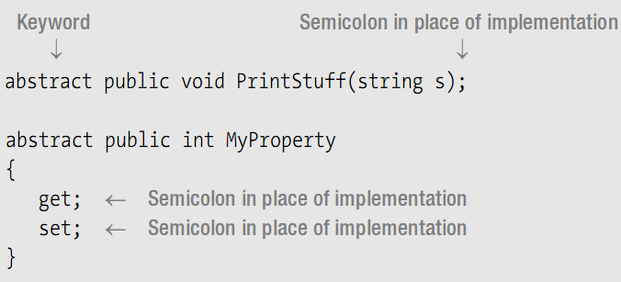
Abstract Members
抽象成员
An abstract member is a function member that is designed to be overridden

Slide 51
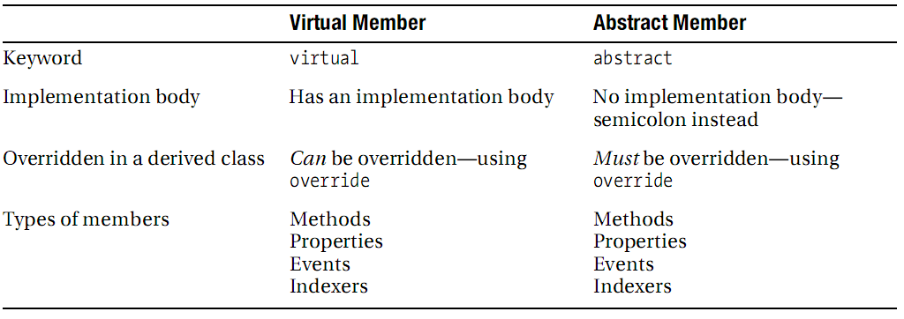
Comparing Virtual and Abstract Members

Slide 52
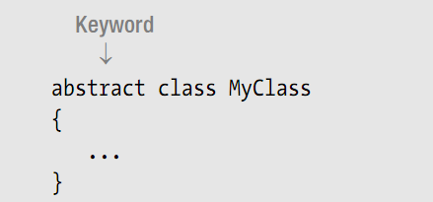

Abstract Classes
抽象类
An abstract class can be used only as the base class of another class.
An abstract class can contain abstract members, but that is not a requirement.
An abstract class can itself be derived from another abstract class.

Slide 53
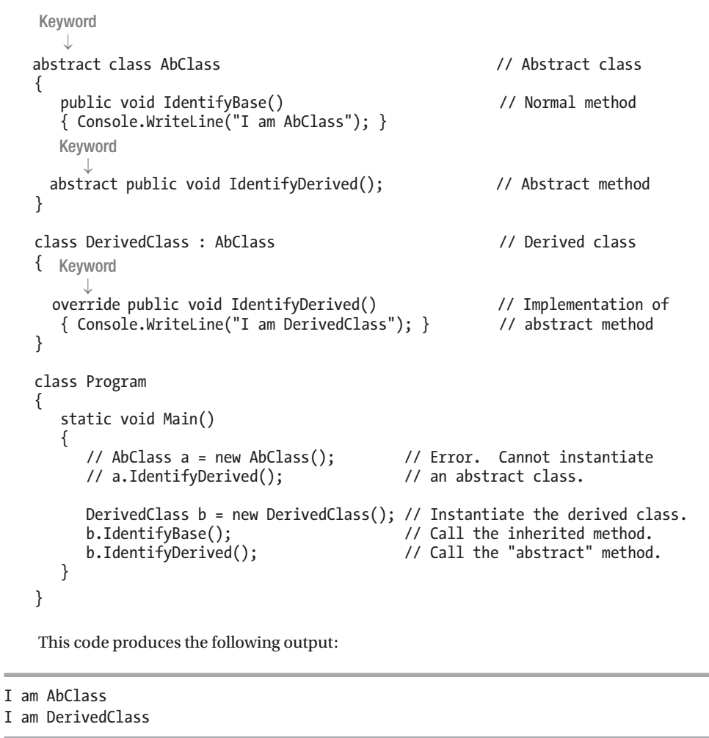
Abstract Classes
Demo

Slide 54
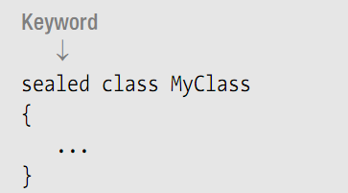
Sealed Classes
密封类
A sealed class can be used only as a stand-alone class—it cannot be used as a base class.

Slide 55
Static Classes
静态类
A static class is a class where all the members are static.
You cannot inherit from static classes—they’re sealed.

Slide 56
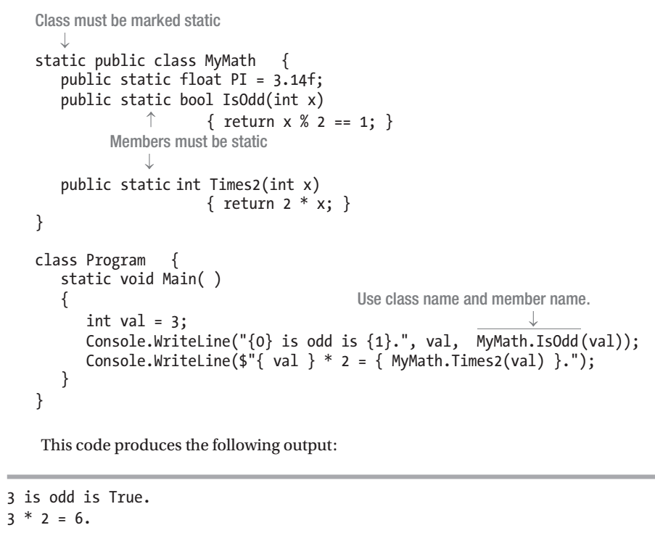
Static Classes

Slide 57
Extension Methods
扩展方法
If you don’t have access to the code, or the class is sealed, or there is some other design reason that neither of these solutions will work, then you will have to write a method in another class that uses the publicly available members of the class.

Slide 58
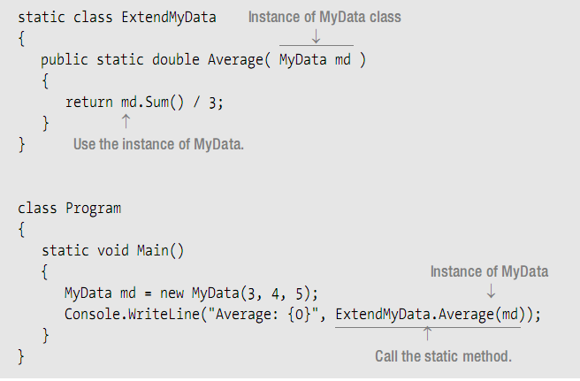
solution 1: contains a static class called ExtendMyData

Slide 59

Solution2:Extension Methods
Extension methods allow you to use the second form, even though the first form would be the normal way of writing the invocation.

Slide 60
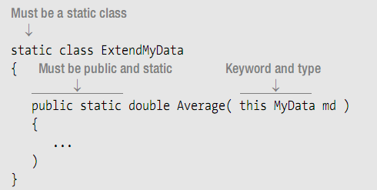
Extension Methods

Slide 61
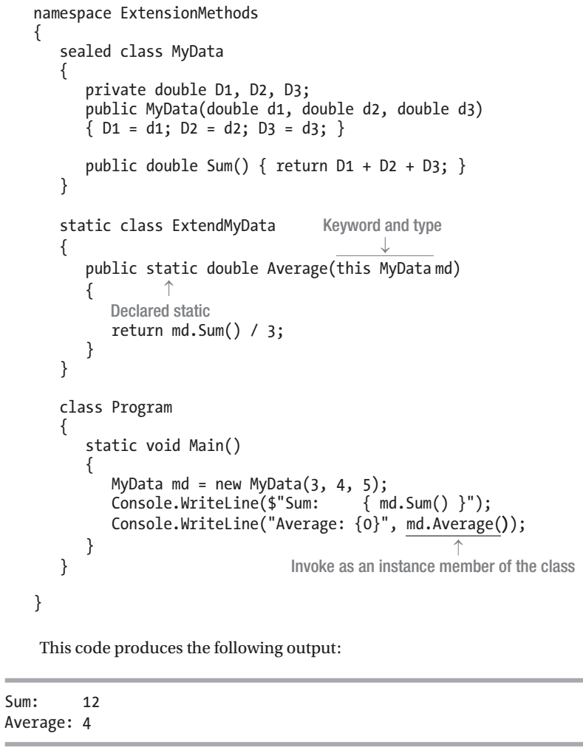
Extension Methods
Demo

Slide 62
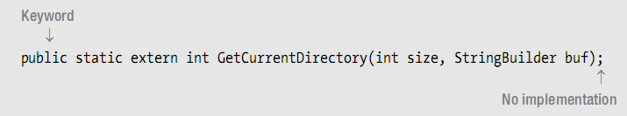
External Methods
An external method is a method that does not have an implementation in the declaration.
Often the implementation is in a language other than C#
often done using the DllImport attribute.

Slide 63
External Methods
Demo

Slide 64
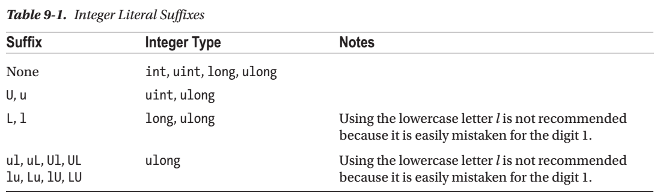

Slide 65
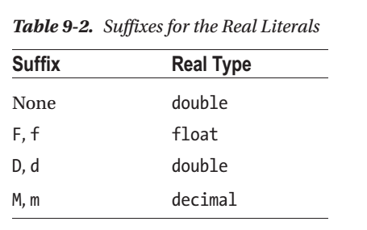

Slide 66
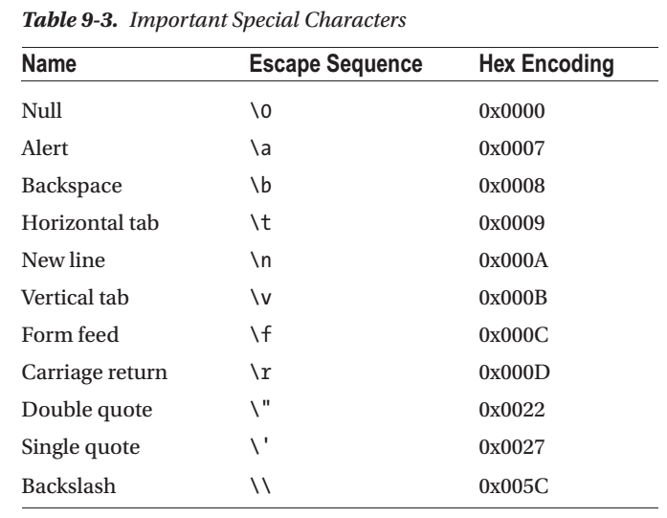

Slide 67
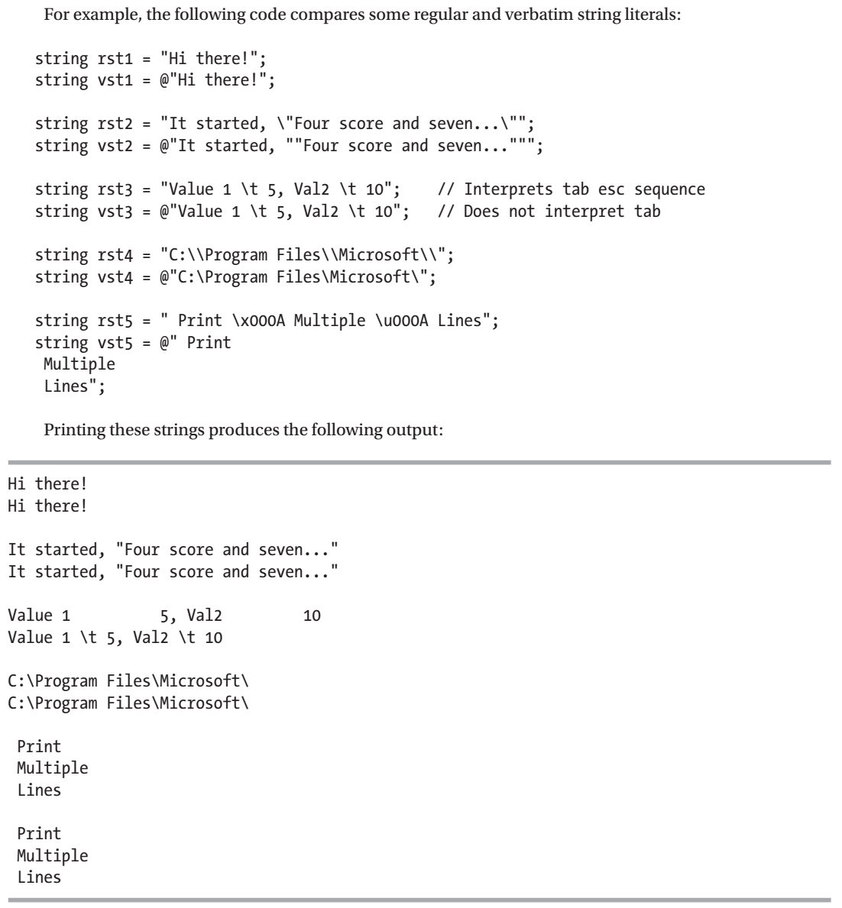
String Literals

Slide 68
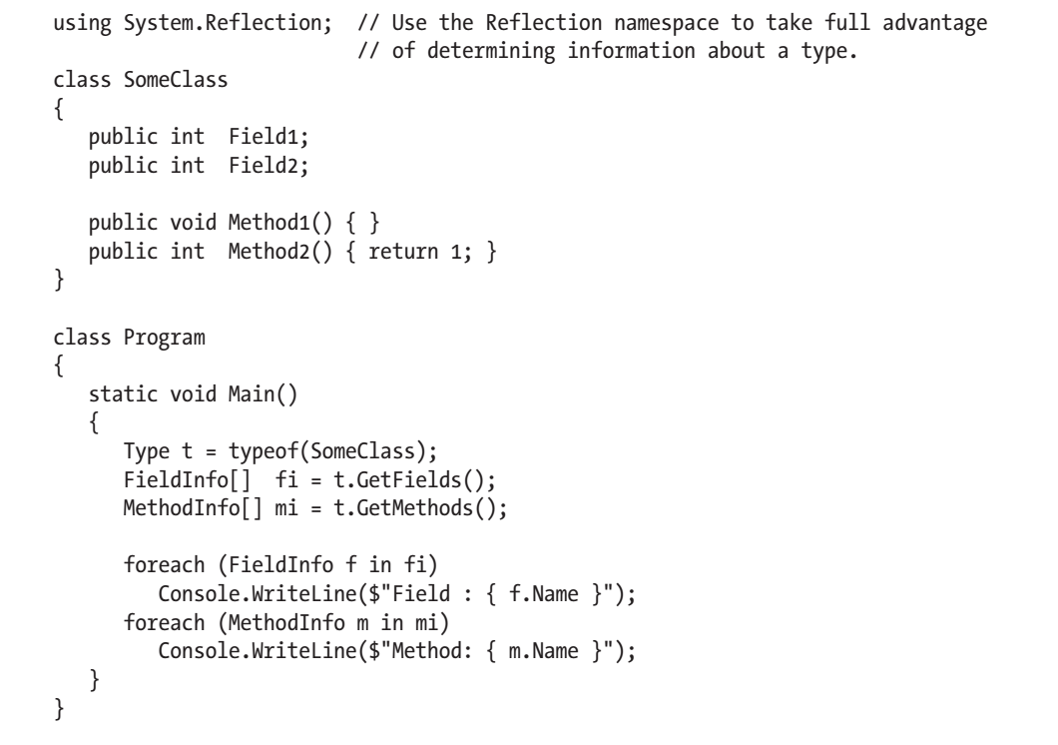
The typeof Operator

Slide 69


Slide 70

The nameof Operator

Slide 71


终于
结束啦！

